Slide 1
Network Security
Md. Sajid
Information & Communication Technology
Batch 20th
Home district: Magura

Slide 2
Topic
Overview of OSI Model & Encapsulation.
Various Types of Protocols & Servers.
Discuss about NMap, Wireshark, Network Miner tools etc.
Packet Capture File Analysis Using Wireshark.
Introduction about Incident Handling Captured-packet analysis etc.
Problem Solving & Discussion.
● Active Reconnaissance & Passive Reconnaissance.

Slide 3
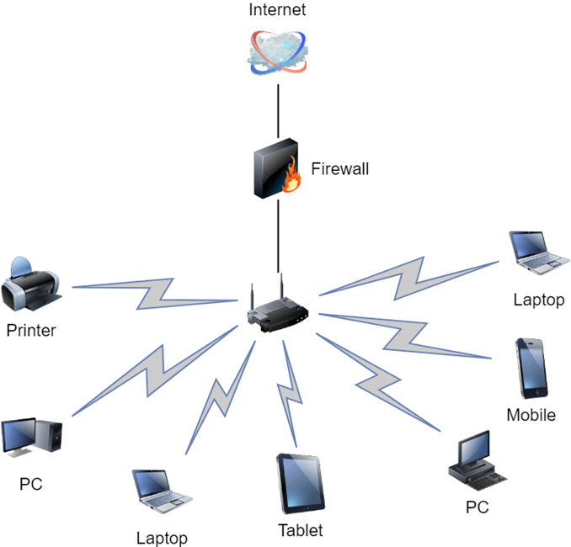
Networking

Slide 4
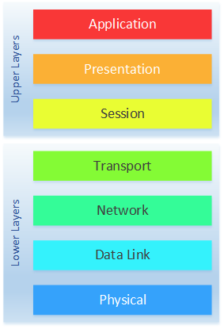
Open System Interconnection(OSI) Model

Slide 5
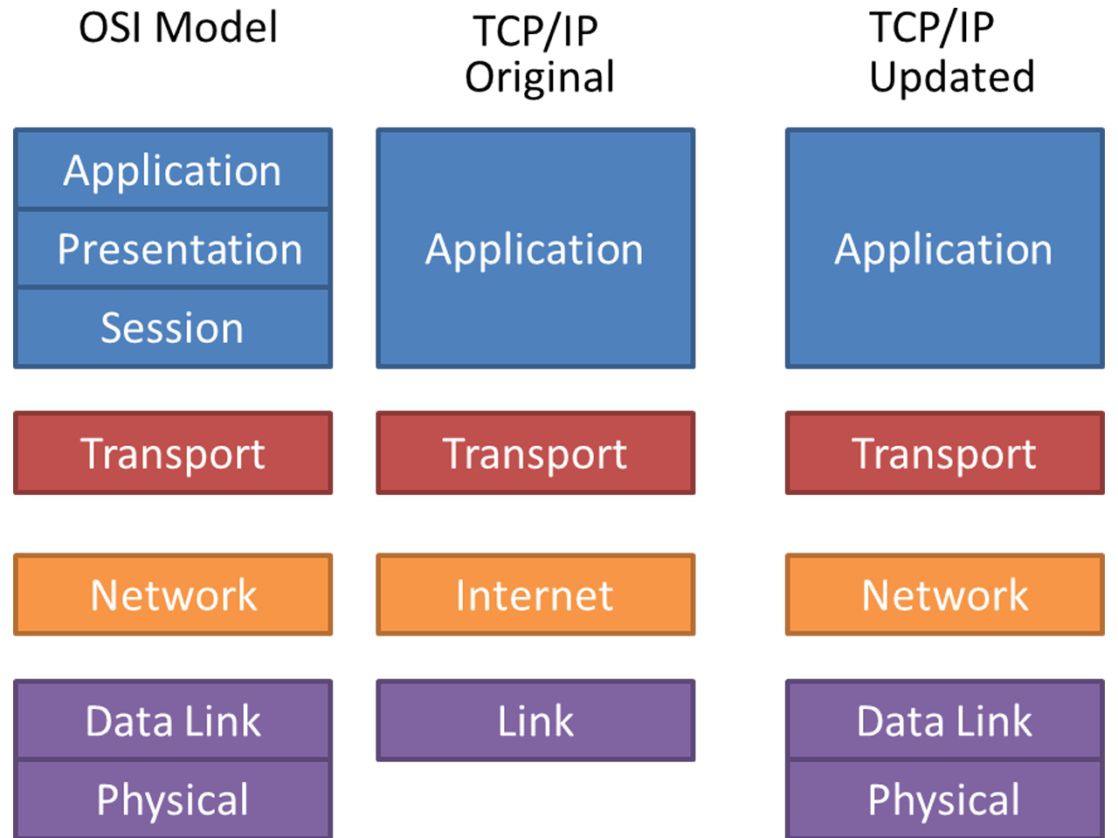
TCP/IP Model

Slide 6
Application Layer
Used for Network Application. Such as Browser ,Skype ,Email system etc.
Protocols-
DNS (Domain Name System)
SMTP (Simple Mail Transfer Protocol)
FTP (File Transfer Protocol)
POP3 (Post Office Protocol vs 3)
HTTP (Hyper Text Transfer Protocol)
TELNET,DHCP,SSH,HTTPS

Slide 7
Presentation Layer
Receive data from application layer.
Translation ASCII to EBCDIC/Hexa.
Data Compression Reduce the number of bit.
Data encryption encrypted the sensitive data.
Protocols-
SSL (Secure Socket Layer)

Slide 8
Session Layer
Session Management
Authentication Who you are?
Authorization Do you have permission for access?
Protocols-
APIs (Application Program Interfaces)
NetBIOS
W

Slide 9
Transport Layer
Control the reliability of communication.
Segmentation divided big data into small data.
Each segment having a sequence number, a source port number and a destination port number.
Flow Control
Error Control Automatic Repeat Request.
A group of bit call Checksum each segment for find out the error.
Protocols-
TCP (Transmission Control Protocol)
UDP (User Datagram Protocol)

Slide 10
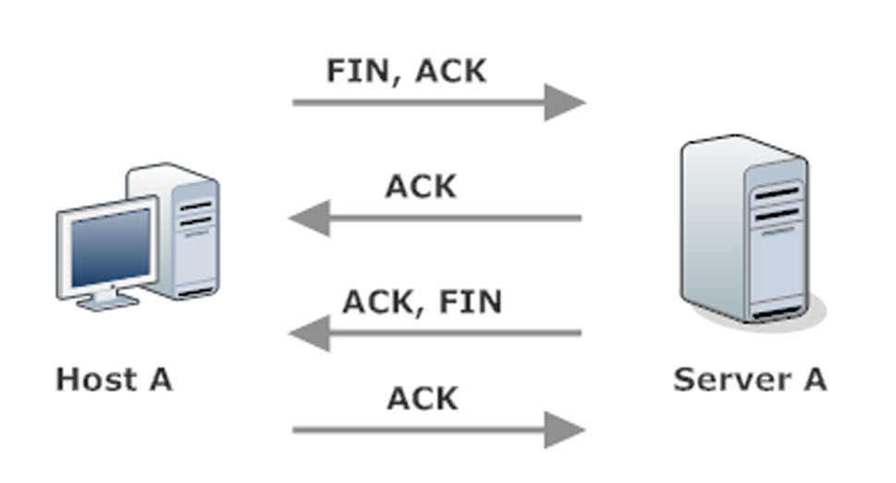
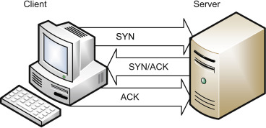
TCP & UDP
TCP (connection-oriented)
3 Way Handshake 4 Way Handshake
UDP(Connectionless)

Slide 11
Network Layer
Receive data segment from Transport layer.
Logical addressing
Added a source IP and destination IP with segment and create a data packet.
Path Determination based on IPv4/IPv6 and Mask
Routing data pass with a shortest and best way
Protocols-
IPv4
IPv6

Slide 12
Data Link Layer
Receive data packet from Network layer.
Physical Addressing
Added a source MAC address and destination MAC address with data packet and make Ethernet frame.
Access the media.
Media access Control.
Error detection

Slide 13
Physical Layer
Convert Binary bits into signal with line coding.
Modulation
Demodulation

Slide 14
Firewall
Creates a safety barrier between a private network and a public network.
Packet filtering.
403 Forbidden.

Slide 15
Virtual Private Network(VPN)
Access the private network virtually.
Redirect.
Tunnelling protocol.

Slide 16
Protocols
SMB (Server Message Block)
ARP (Address Resolution Protocol)
TFTP (Trivial File Transfer Protocol)
TLS (Transport Layer Security)

